Slide 1
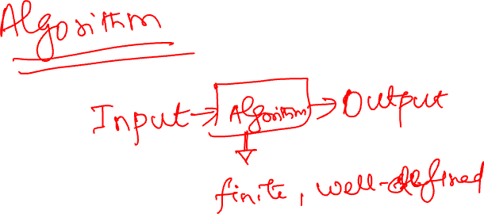
Foundations of Quantum Algorithms
Notes:
Speaker Notes:
Define Algorithm, Draw Diagram, Examples

Slide 2
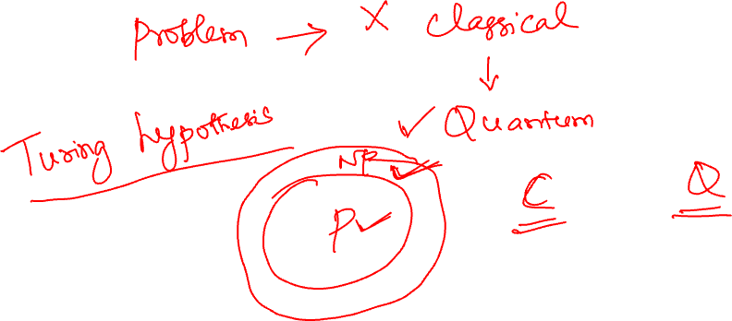
Why Do We Need Quantum Algorithms?
Notes:
Speaker Notes:
Faster CPUs, Larger Memory, Parallel processing, Smaller transistors…. Ask Question

Slide 3
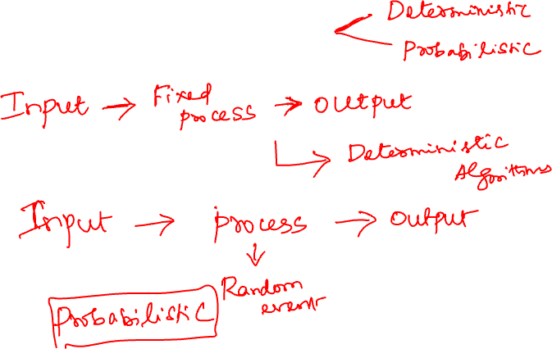
Types of Classical Algorithms
Notes:
Speaker Notes:
End by asking whether there is another computational paradigm beyond classical.

Slide 4
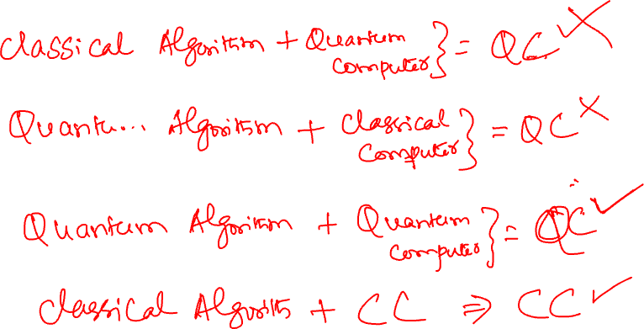
Classical vs Quantum Paradigm – Common Misconception
Notes:
Speaker Notes:
Explain quantum simulators such as Qiskit Aer.

Slide 5
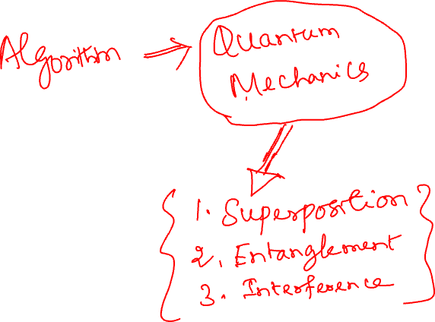
What is Quantum Computing?
Notes:
Speaker Notes:
Stress that quantum computing changes the model of computation.

Slide 6
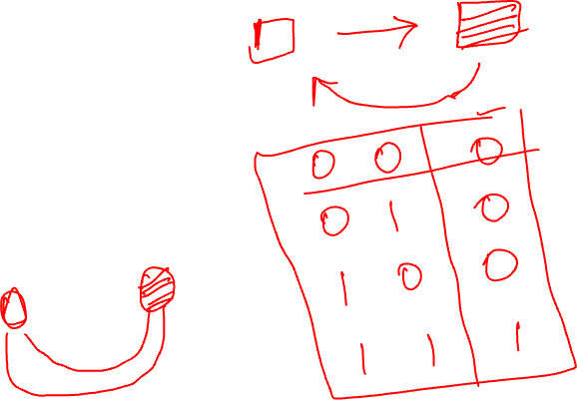
From Bits to Qubits
Classical Bit: 0 or 1
Quantum Bit (Qubit): |0⟩, |1⟩, or a superposition of both.
Comparison:
• Classical: Definite state
• Quantum: Probability amplitudes until measurement
Notes:
Speaker Notes:
Avoid heavy mathematics; focus on intuition.

Slide 7
Building Blocks of Quantum Algorithms
Quantum algorithms exploit:
• Superposition
• Interference
• Entanglement
Notes:
Speaker Notes:
Transition to algorithm demonstrations.

